Slide 1
Analysis of HDI and Good Governance Indices
Huseyn Rufin Elnur

Slide 2
Project analysis slide 2
Content
Analysis of relationship between decomposed HDI and GDP Per Capita
Relationship between Good governance indices and HDI
Human Development Index vs Good Governance Indices - which is better at classification

Slide 3

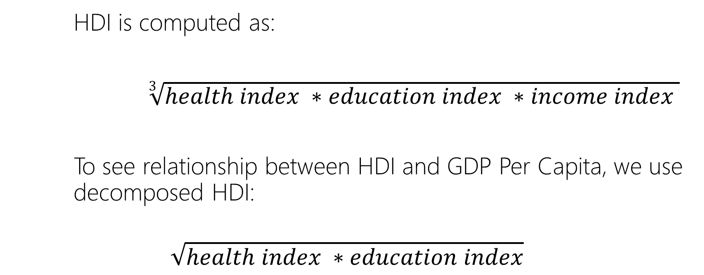
Project analysis slide 2
Analysis of relationship between decomposed HDI and GDP Per Capita
HDI is computed as:
$\sqrt[3]{health index ∗education index ∗income index }$
To see relationship between HDI and GDP Per Capita, we use decomposed HDI:
$$\sqrt{health index ∗education index}$$

Slide 4
Project analysis slide 5
Analysis of relationship between decomposed HDI and GDP Per Capita
A percentage increase in GDP Per Capita increases HDI by 0.000897 units
Linear relationship is statistically significant
Correlation coefficient: (HDI decomposed and in (GDP per cap))- 0.884 (Strong Positive)
Notes:
Lower bound 0.082693
Upper bound 0.096727

Slide 5
Project analysis slide 5
Analysis of relationship between decomposed HDI and GDP Per Capita
Via polynomial regression at degree 3, we can find that point of diminishing marginal utility is x = 50.000 dollars per capita GDP
*removed Luxembourg as outlier
Notes:
Second derivative = 0 is used
https://corporatefinanceinstitute.com/resources/knowledge/economics/point-of-diminishing-returns/
If asked:
1st derivative = 0 will be x(gdp per cap) =50000 (same with 2nd derivative)

Slide 6
Project analysis slide 5
Analysis of relationship between decomposed HDI and GDP Per Capita
With polynomial degree of 4, point(s) will yield:
X = 27128 (practically and mathematically)
and
X = 122871 dollars (mathematically)
Notes:
Second derivative = 0 is used
https://corporatefinanceinstitute.com/resources/knowledge/economics/point-of-diminishing-returns/
If asked:
1st derivative = 0 will be x = 169476 , 14320.6 and 41203.05

Slide 7
Project analysis slide 5
Relationship between Good governance indices and HDI
Correlation between variables (2019)
 | Control of corruption | Gov effectiveness | Political stability | Regulatory quality | Rule of law | Voice and accountability
Control of corruption
Gov effectiveness | 0.92
Political stability | 0.77 | 0.74
Regulatory quality | 0.87 | 0.94 | 0.68
Rule of law | 0.95 | 0.94 | 0.78 | 0.92
Voice and accountability | 0.77 | 0.71 | 0.68 | 0.75 | 0.78
HDI | 0.73 | 0.86 | 0.62 | 0.80 | 0.77 | 0.58

Slide 8
Project analysis slide 5
Relationship between Good governance indices and HDI
A unit increase in government effectiveness increases HDI by 0.1323 points
Statistically significant relationship
* given heteroskedasticity problem
Notes:
Lower bound 0.120399
Upper bound 0.144168 for coefficient

Slide 9


Project analysis slide 5
HDI vs Good Governance Indices which one is better at classification
Decision Tree Classifier result if all variables included
HDI < 0.863
Control of corruption < -2.366
Regulatory quality < 1.013
Developing
Developed
Developing
Developed
Notes:
More than 90% accuracy

Slide 10
Project analysis slide 5
HDI vs Good Governance Indices which one is better at classification
Decision Tree Classifier result among good governance indices
Regulatory quality < 1.013
Government effectiveness < -2.366
Political stability < 0.071
Developing
Developed
Developing
Developed
Notes:
More than 90% accuracy, but model which uses HDI is better at accuracy

Slide 11
Project analysis slide 5
HDI vs Good Governance Indices which one is better at classification
If all variables included
Among good governance indices

Slide 12
Resources
hdr.undp.com
https://info.worldbank.org/governance/wgi/
https://corporatefinanceinstitute.com/resources/knowledge/economics/point-of-diminishing-returns/

Slide 13
Thank You

